Slide 1
Where’s the Green?
A data-driven map for town planners and health and social care professionals

Slide 2
Who are we?
Helena: nurse for care of the older person and cardiothoracic surgery
Tom: PhD student in ovarian cancer science
Lucy: Computer science graduate in the social care sector
Kirstin: MSc in Big Data

Slide 3
What’s the Problem?
Dundee has large zones of deprivation and ill health
Evidence shows that local access to green spaces has a positive effect on health and wellbeing
Geographic and social data exists in isolation, without effective interpretation communities cannot effectively plan
Notes:
Evidence: WHO, UN, NHS Scotland

Slide 4
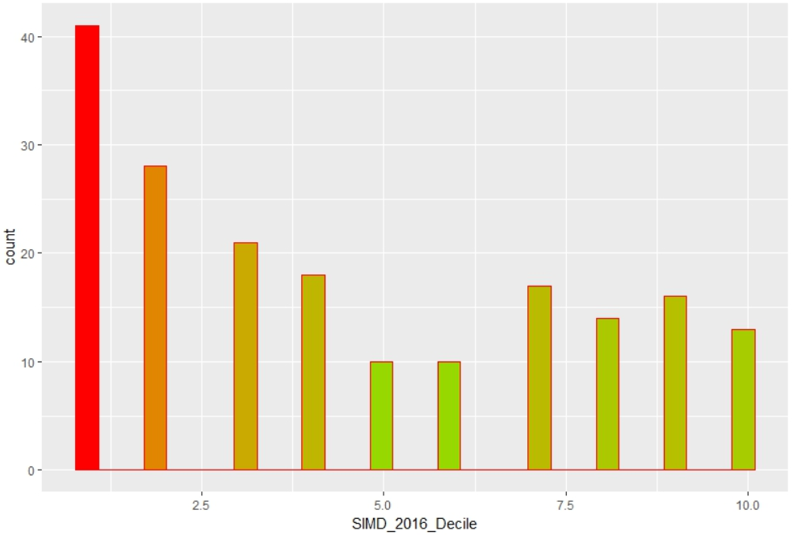
Scottish Index of Multiple Deprivation 2016
41 zones (22%) are in the most deprived 10% of Scotland

Slide 5
Why don’t current approaches work?
Dundee Physical Activity Strategy 2017: Active Chances Active Choices
Encourages activity without considering underlying barrier to access
Open Space 2010: Edinburgh Open Space Strategy
Didn’t take deprivation into consideration, unclear about data
Glasgow Indicators Project: Access to Green Space
No visualisation, no interactivity, focuses on children only

Slide 6
What do we do differently?
Data-driven approach to resource allocation and social problems
Allows the user to visually layer data and explore interaction e.g.
Health data
Geographic data
Visualise ease of access to green space
Extendible: uses open data, no limits on data that can be added
Notes:
High level overview of project

Slide 7
How does it work?
Open data sets: SIMD16, OS Green Spaces
Tools:
QGIS
Python
Data stored in geoJSON format
Leaflet and JavaScript
Process:
Data identification and retrieval
Data processing and filtering
Display

Slide 8
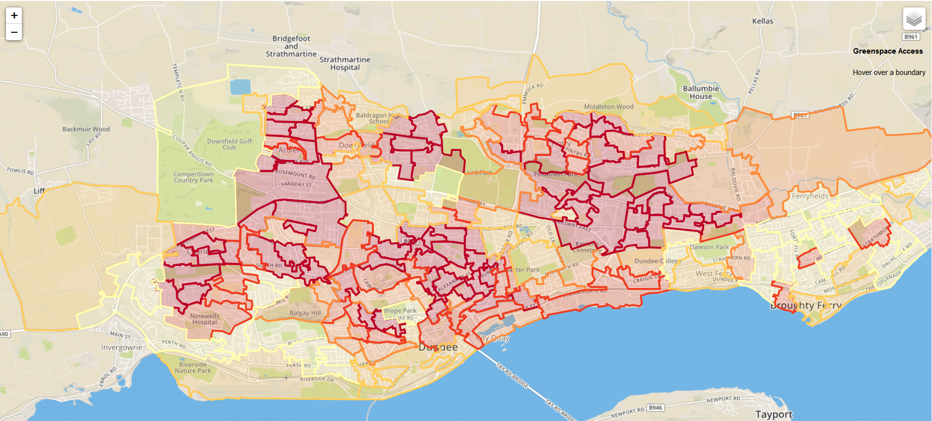
Scottish Index of Multiple Deprivation
SIMD Health Index X 2011 Census Data Zone Boundaries X 2011 Data Zone Centroids

Slide 9
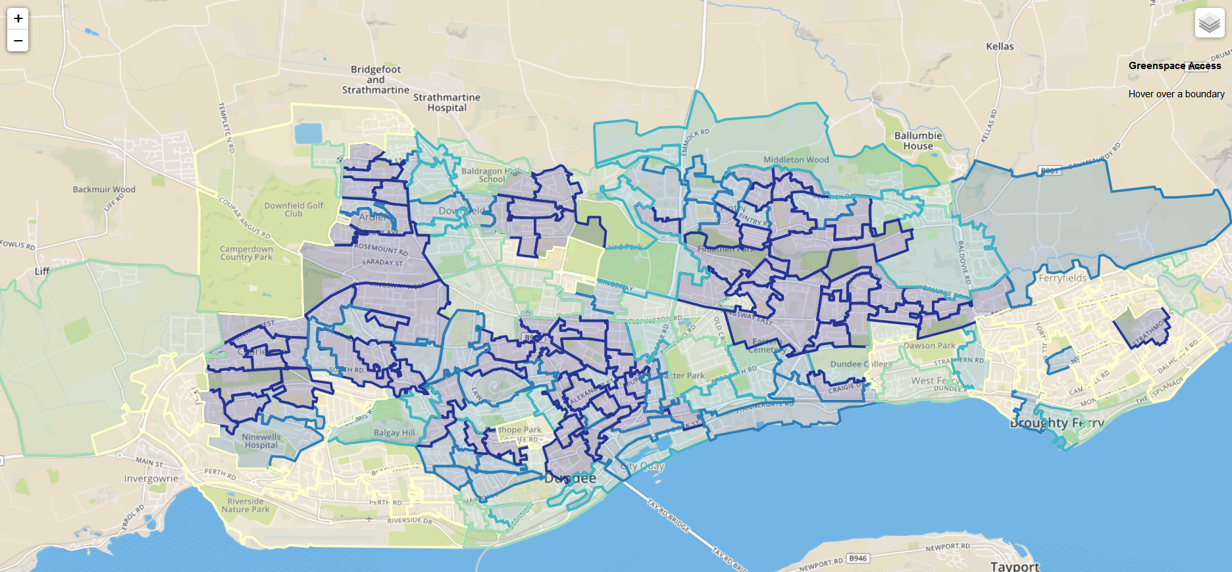
Scottish Index of Multiple Deprivation (Rank Within Dundee)
SIMD Health Index (Dundee Health Board) X 2011 Census Data Zone Boundaries X 2011 Data Zone Centroids

Slide 10
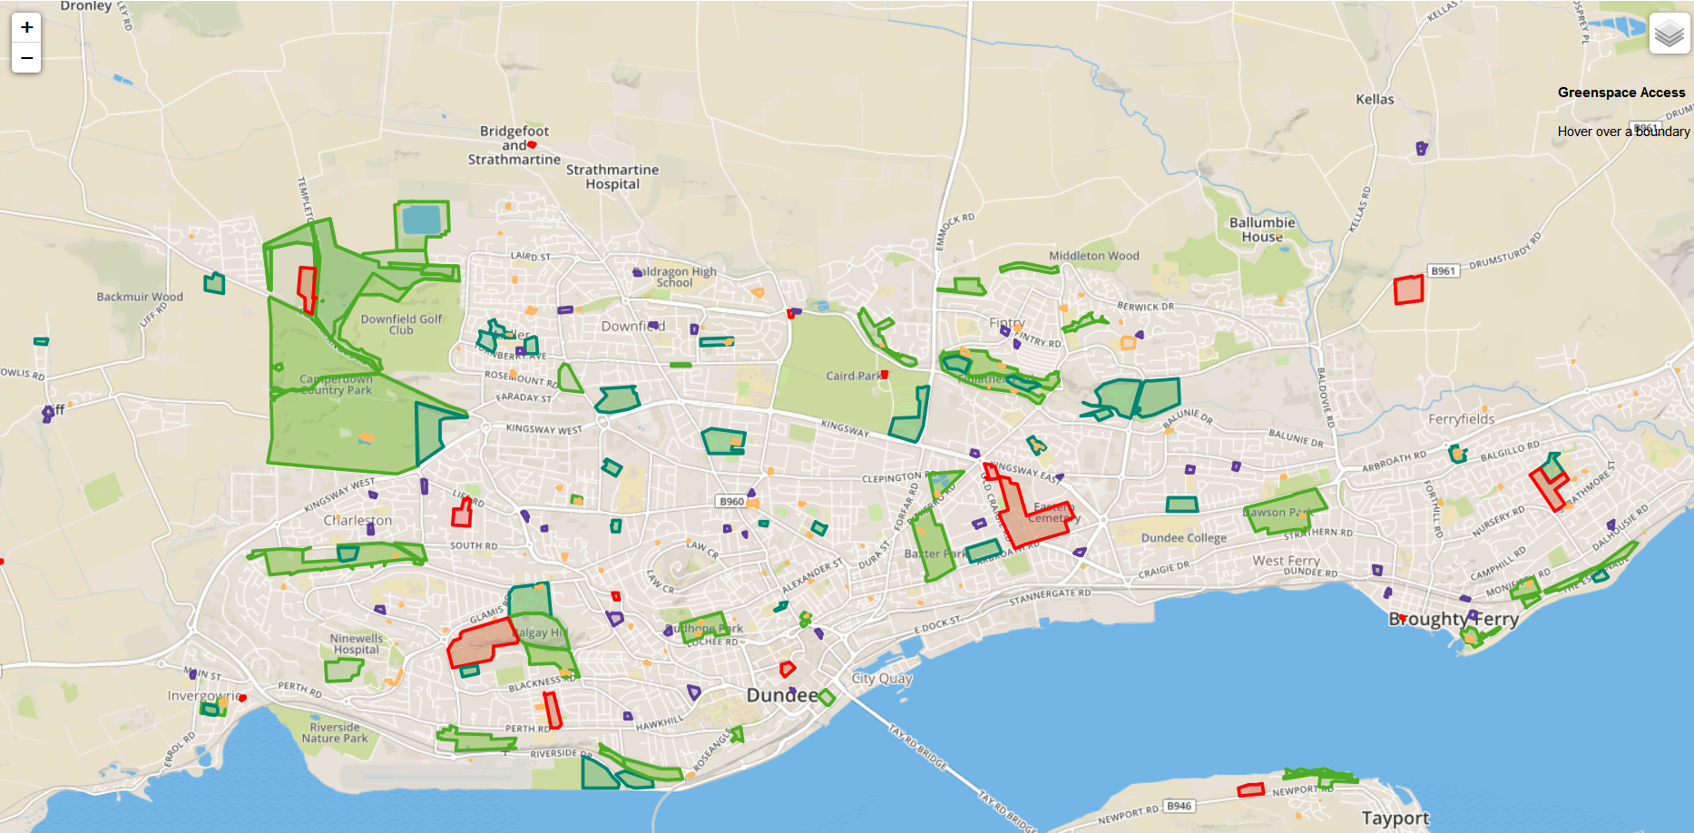
Green Spaces
Green Spaces Polygons X Green Spaces Access Points X 2011 Census Centroids = meaningful data on green space access

Slide 11
Where do we go from here?
6 months to viable prototype
Expansion to other cities and towns
Implement progress monitoring- how has quality of life changed?

